Slide 1
CIFAR-10 CNN CLASSIFICATION
INFO 7390 Final Project
Akshaya Suresh, Rakshit Shah, Ran Wei, Lixi Zhou

Slide 2
Content
Introduction : about the project
Structure of the CNN model : conv layer, pool layer, etc.
Tensorflow model: performance, the accuracy
Keras model: performance, the accuracy
Data processing : rotation, normalization
Result & Finding

Slide 3
Computational Resources
AWS EC2 Instance - Deep Learning AMI (Ubuntu) Version 7.0
p2.xlarge (11.75 ECUs, 4 vCPUs, 2.7 GHz, E5-2686v4, 61 GiB memory, EBS only)
Personal Laptop
NVIDIA GEFORCE GTX960M - 4GB
NVIDIA GEFORCE GTX965M - 2GB

Slide 4
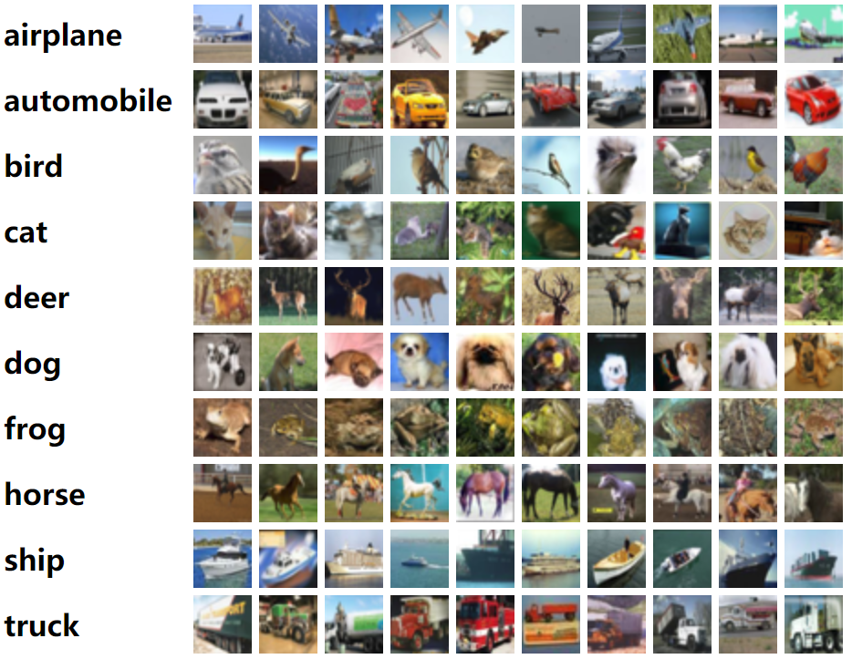
Introduction - CIFAR 10 dataset
A dataset contains 60,000 32x32 colour images in 10 classes.
50,000 training images and 10,000 test images.
Each dataset has its own R/G/B data and its label information.

Slide 5
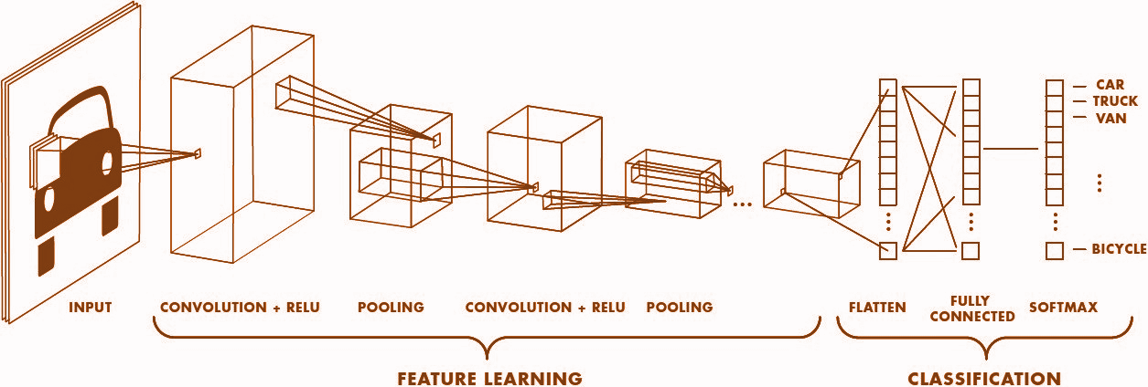
Block Diagram

Slide 6
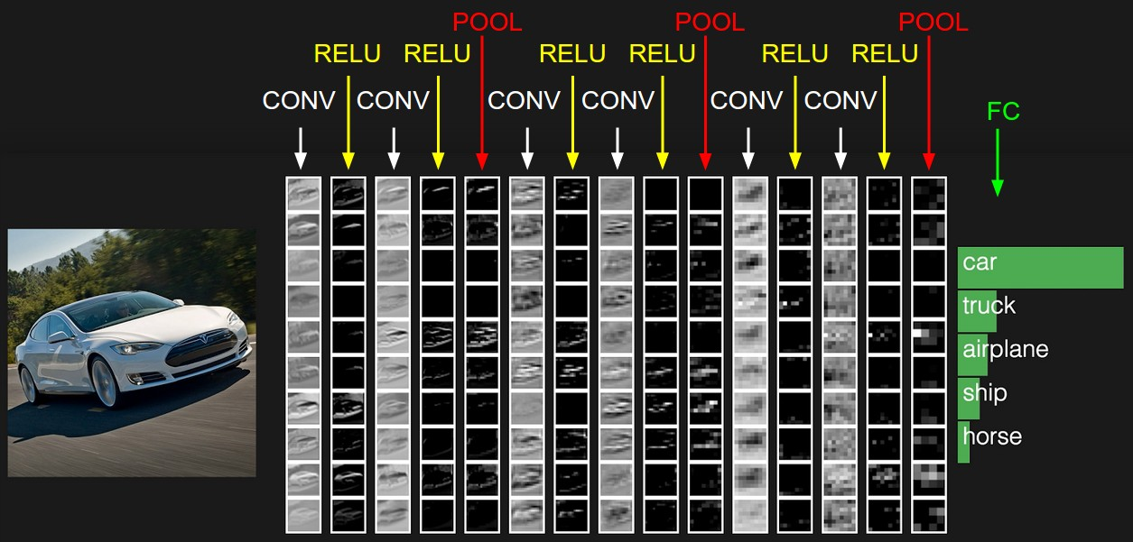
Structure of CNN model

Slide 7
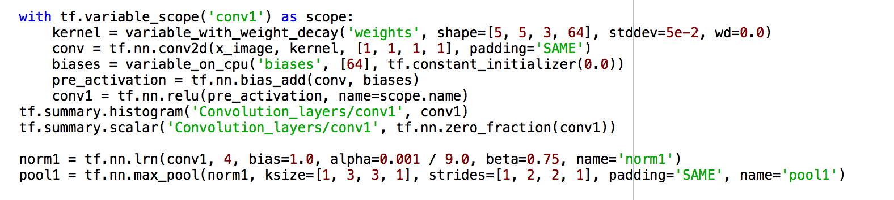
CNN using tensorflow on CIFAR-10
5 convolution layers with 3 Maxpool layers
With 10000 iterations
No data augmentation

Slide 8
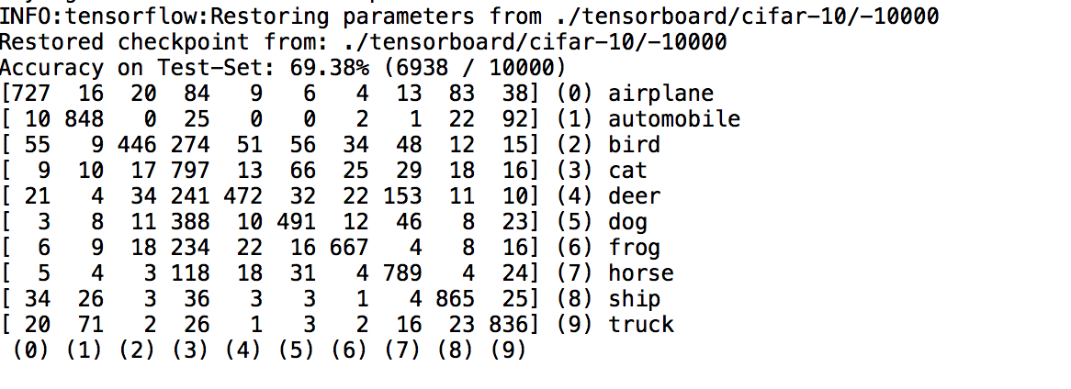
Results of tensorflow
Misclassification among the animals

Slide 9
What is Keras? Why use it?
Neural Network library written in Python
Designed to be minimalistic & straight forward yet extensive
Built on top of either Theano as newly TensorFlow
Simple to get started, simple to keep going
Written in python and highly modular, easy to expand
Deep enough to build serious models

Slide 10
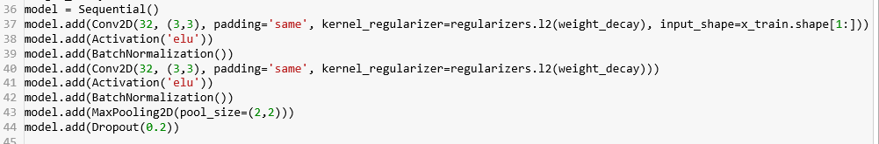
How does it work in Keras?
Using Keras is like working with Lego blocks.

Slide 11
Keras Architecture
We saw previously that shallow architecture was able to achieve 69% accuracy only.
The advantage of multiple layers is that they can learn features at various levels of abstraction.
The process of building a Convolutional Neural Network majorly involves four major blocks show below. Convolution layer ==> Pooling layer ==> Flattening layer ==> Dense/Output layer
We will build a 6 layered convolution neural network followed by flatten layer. The output layer is dense layer of 10 nodes (as there are 10 classes) with softmax activation

Slide 12
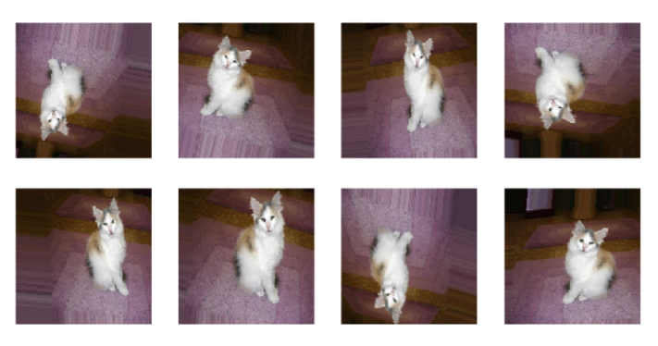
Data Augmentation
Image Augmentation is the process of taking images that are already in a training dataset and manipulating them to create many altered versions of the same image. This both provides more images to train on, but can also help expose our classifier to a wider variety of lighting and coloring situations so as to make our classifier more robust.
Using ImageDataGenerator to increase the size of dataset:
rotation_range=30
width_shift_range=0.1
height_shift_range=0.1
horizontal_flip=True

Slide 13
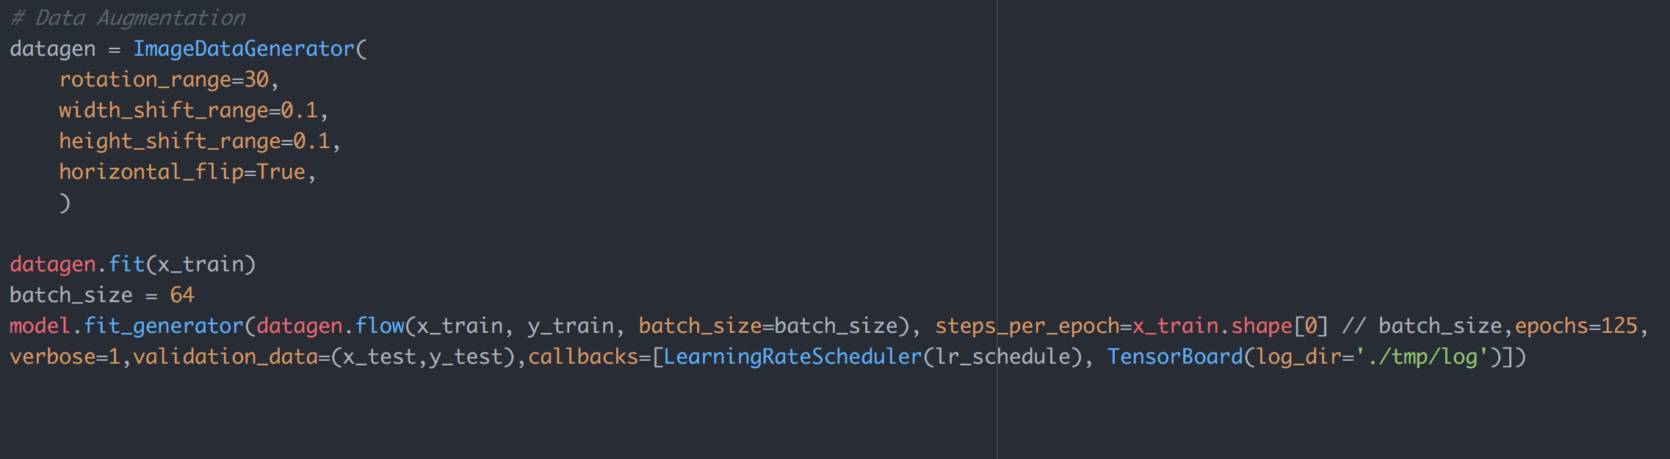
Snippet of the code
Applying ImageDataGenerator to increase the size of the training dataset

Slide 14
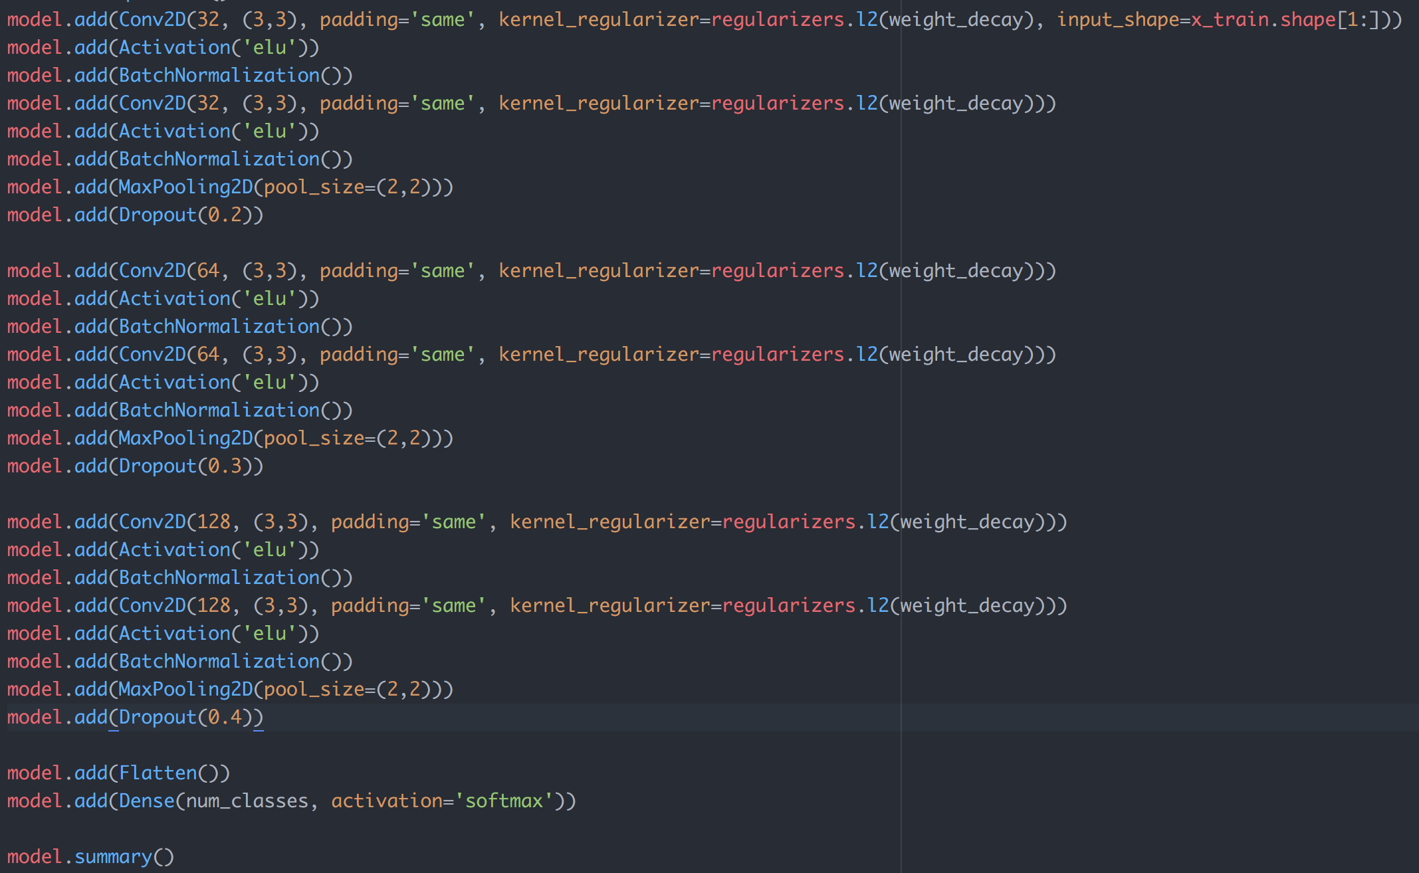
Snippet of the code
Convolutional Layer
Activation: Relu
BatchNormalization Layer
Convolutional Layer
Activation: Relu
BatchNormalization Layer
MaxPooling Layer
Dropout Layer
Flatten Layer
Dense Layer
3*
Notes:
weight_decay, dropout prevent overfitting
batch normalization: improve the speed, or achieving the same accuracy with fewer steps
Dropout -> randomly drop units(along with its connections) during training
Flattern multi dimensions -> one dimensions for fully connected layer

Slide 15
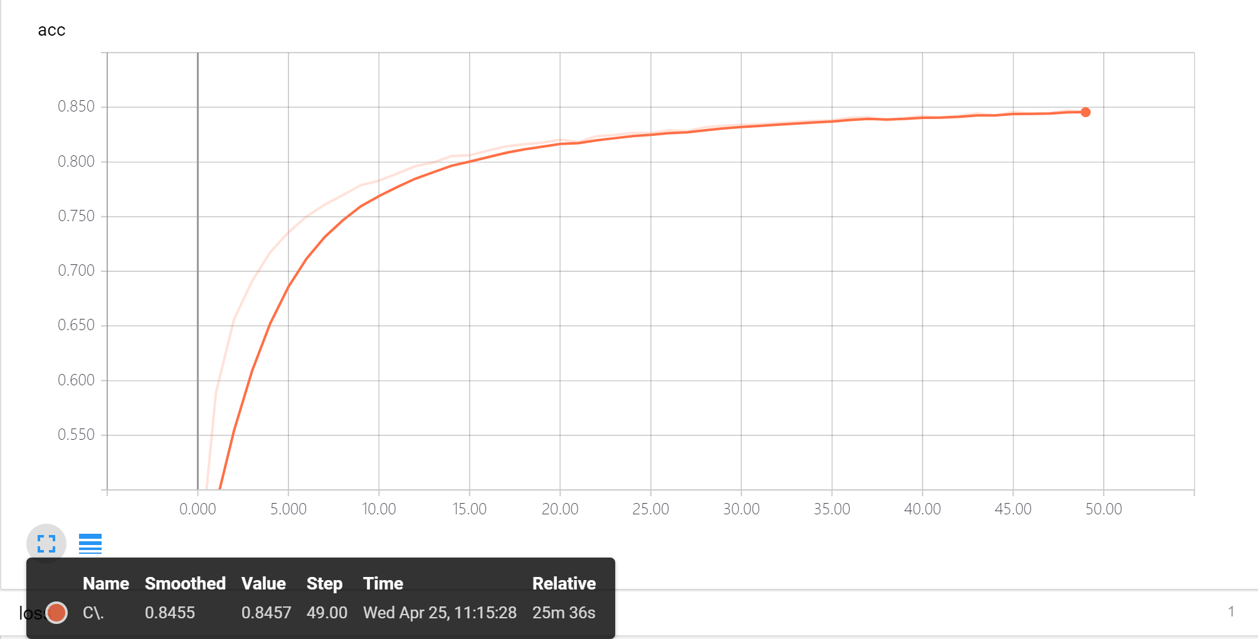
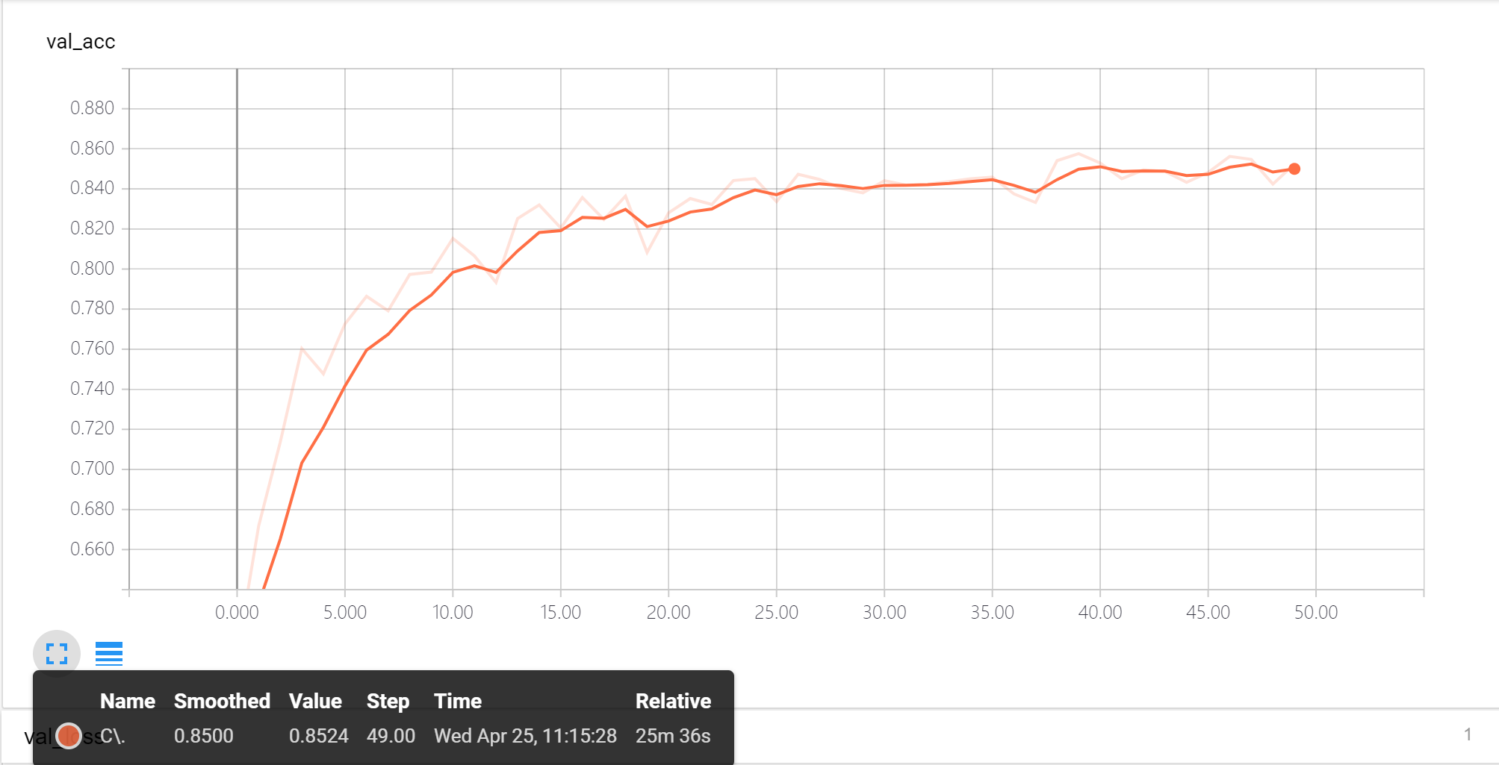
Result - Without data processing
epochs = 50
Accuracy of training data: 0.8457
Accuracy of test data: 0.8524

Slide 16
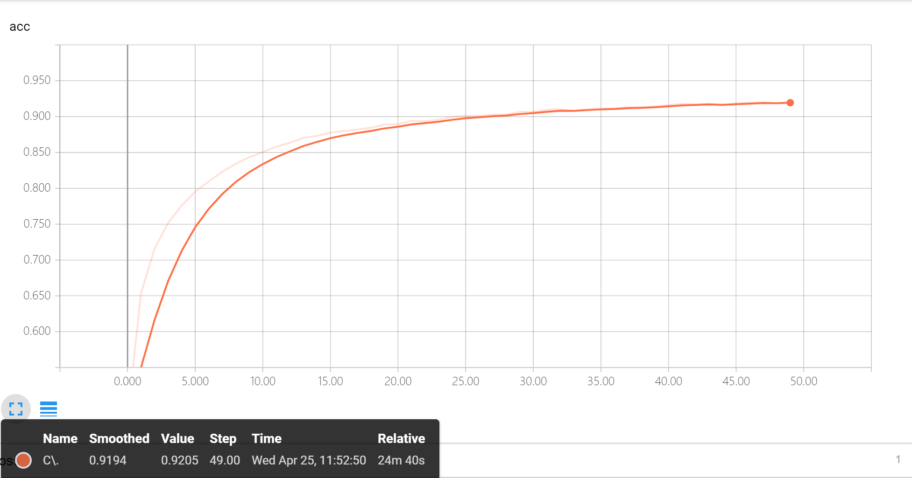

Result - With data processing
epochs = 50
Accuracy of training data: 0.9206
Accuracy of test data: 0.8579

Slide 17

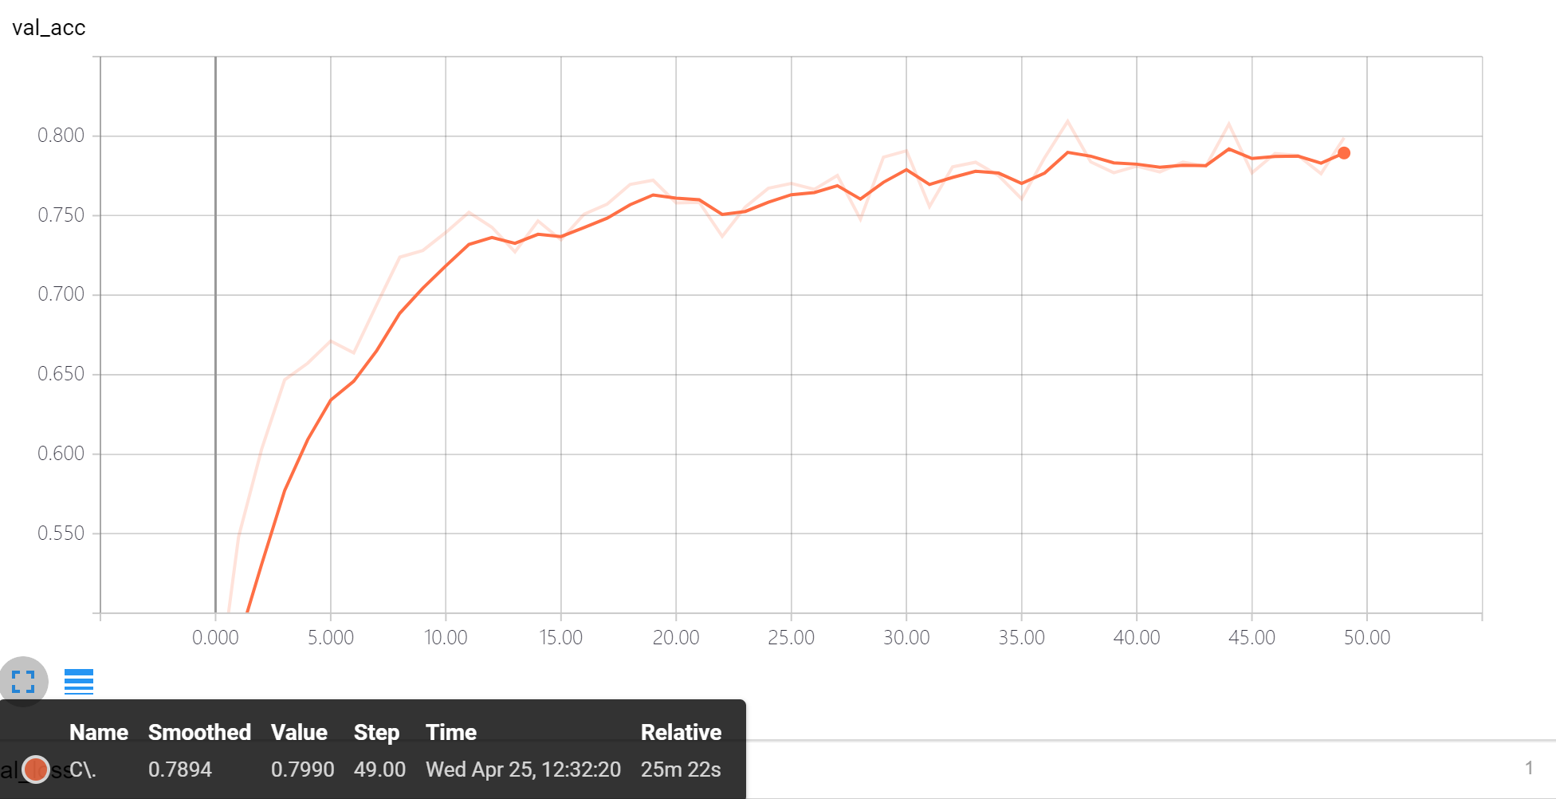
Result - With vertical flip
epochs = 50
Accuracy of training data: 0.7786
Accuracy of test data: 0.799

Slide 18
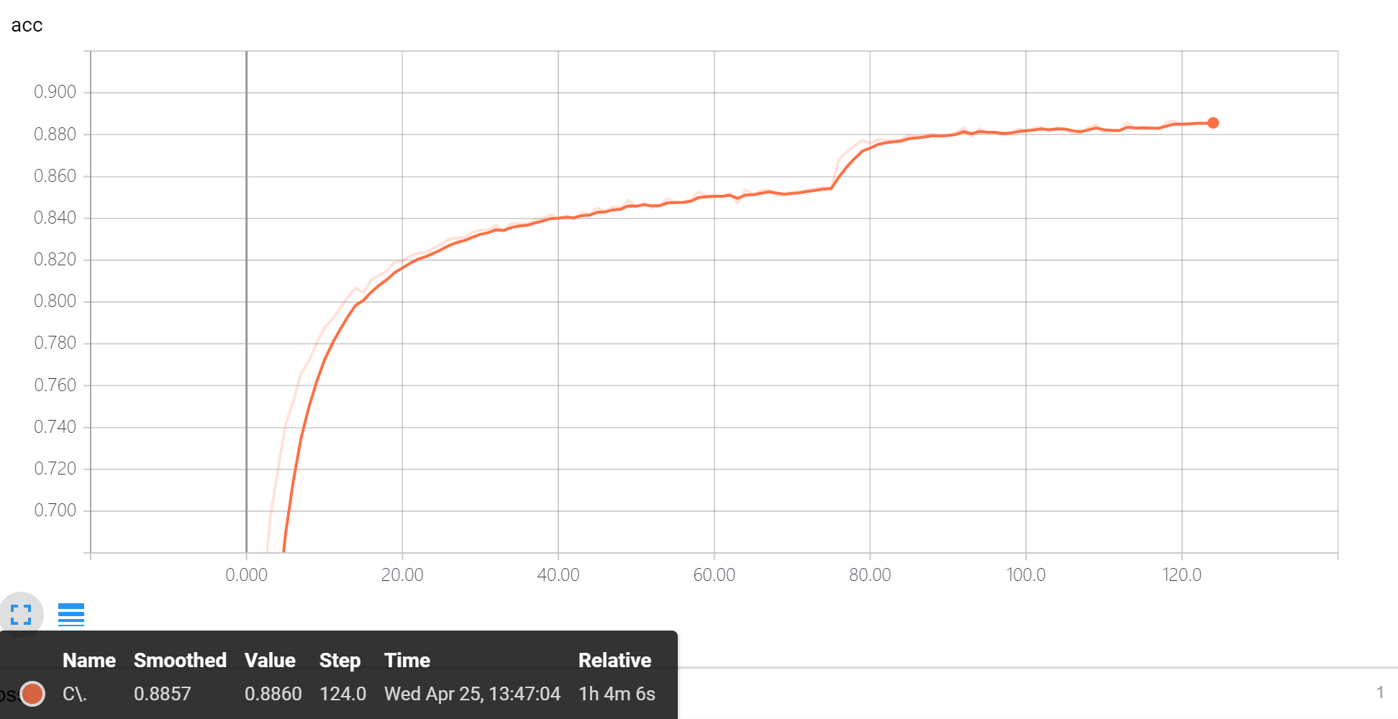
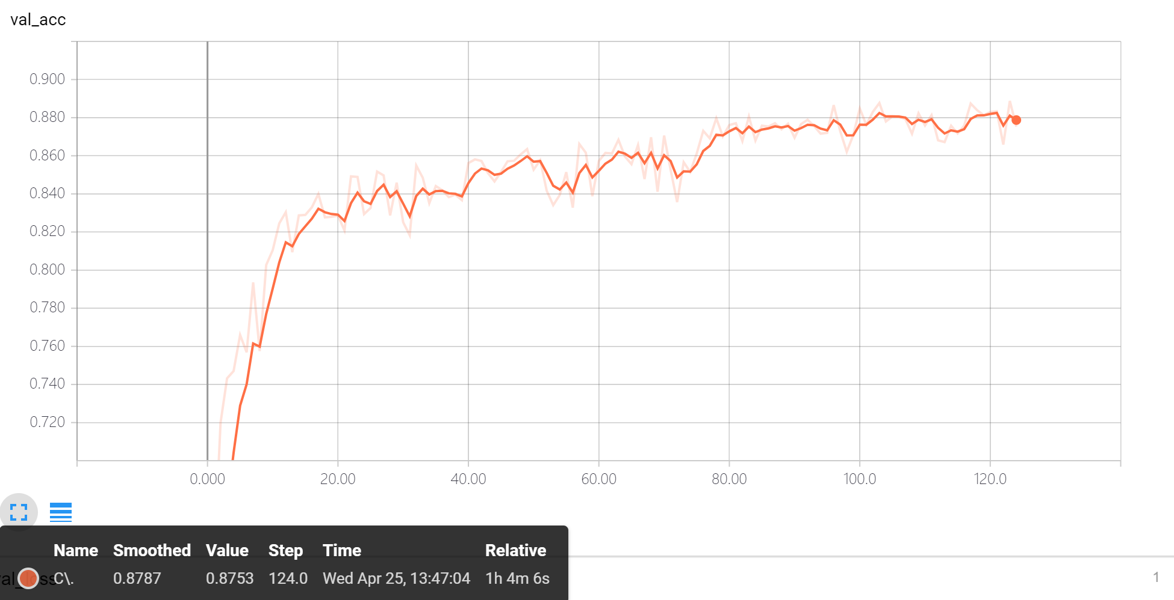
Result
epochs = 125
Accuracy of training data: 0.8860
Accuracy of test data: 0.8753

Slide 19
CIFAR-10 human accuracy is approximately 94%
Thank You

